Slide 1

Lecture 06 – Neural Networks and Neural Language Models
Baojian Zhou
DATA130030.01 (自然语言处理)
School of Data Science Fudan University
04/12/2023

Slide 2
Outline
Units in Neural Networks

Slide 3

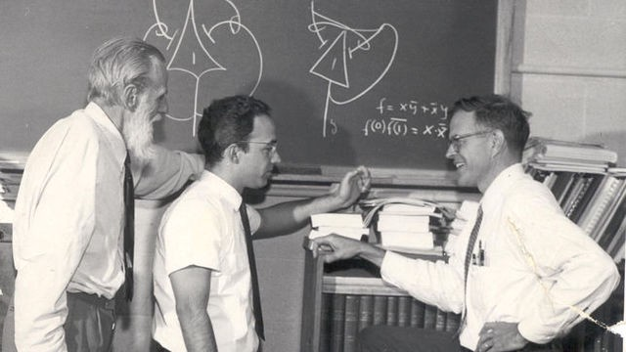
What is a neuron?
细胞体
突触
终树突
细胞核
轴突
神经突触节
高尔基体
First mathematical neuron: In 1943, Warren S. McCulloch, a neuroscientist, and Walter Pitts, a logician, published "A logical calculus of the ideas immanent in nervous activity" in the Bulletin of Mathematical Biophysics.
内质网
树突
线粒体
树突分支
By User BruceBlaus - Own work, CC BY 3.0, https://commons.wikimedia.org/w/index.php?curid=28761830
McCulloch-Pitts Neuron
Notes:
Cell body - 细胞体 - [sel bod-ee]
Nucleus - 细胞核 - [noo-klee-uhs]
Axon hillock - 轴突丘 - [ak-suhn hil-uhk]
Axon - 轴突 - [ak-suhn]
Telodendria - 末梢树突 - [tel-uh-den-dree-uh]
Synaptic terminals - 突触末端 - [sih-nap-tik ter-muh-nuhls]
Endoplasmic reticulum - 内质网 - [en-doh-plaz-mik rih-tik-yuh-luhm]
Golgi apparatus - 高尔基体 - [gohl-jee uh-par-uh-tuhs]
Dendrite - 树突 - [den-drahyt]
Dendritic branches - 树突分支 - [den-drit-ik branch-es]
Mitochondrion - 线粒体 - [mahy-toh-kon-dree-uhn]
---
在1943年，神经科学家Warren S. McCulloch(左一)和逻辑学家Walter Pitts（中间）共同发表了一篇名为
《神经活动中固有思想的逻辑演算》（A logical calculus of the ideas immanent in nervous
activity）的论文，发表在《数学生物物理学报》（Bulletin of Mathematical Biophysics）上。
这篇论文被认为是神经网络研究的开端。

Slide 4
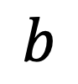
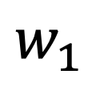
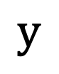
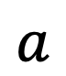
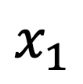
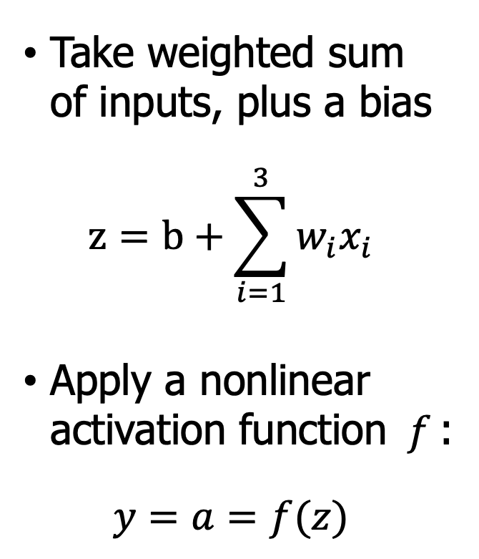

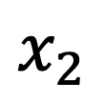

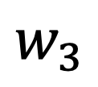
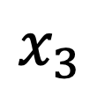

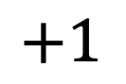
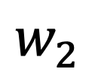
Neural Network Unit
Output value
$$y$$
Take weighted sum of inputs, plus a bias
$$z=b+\sum_{i=1}^{3}{w_{i}x_{i}}$$
Apply a nonlinear activation function $f$:
$$y=a=f(z)$$
$$a$$
Non-linear transform
$$σ$$
$$z$$
Weighted sum
Weights
$$w_{1}$$
$$w_{2}$$
$$w_{3}$$
$$b$$
Input layer
$$x_{1}$$
$$x_{2}$$
$$x_{3}$$
$$+1$$
Notes:
Blue parts are operations

Slide 5
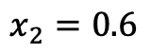
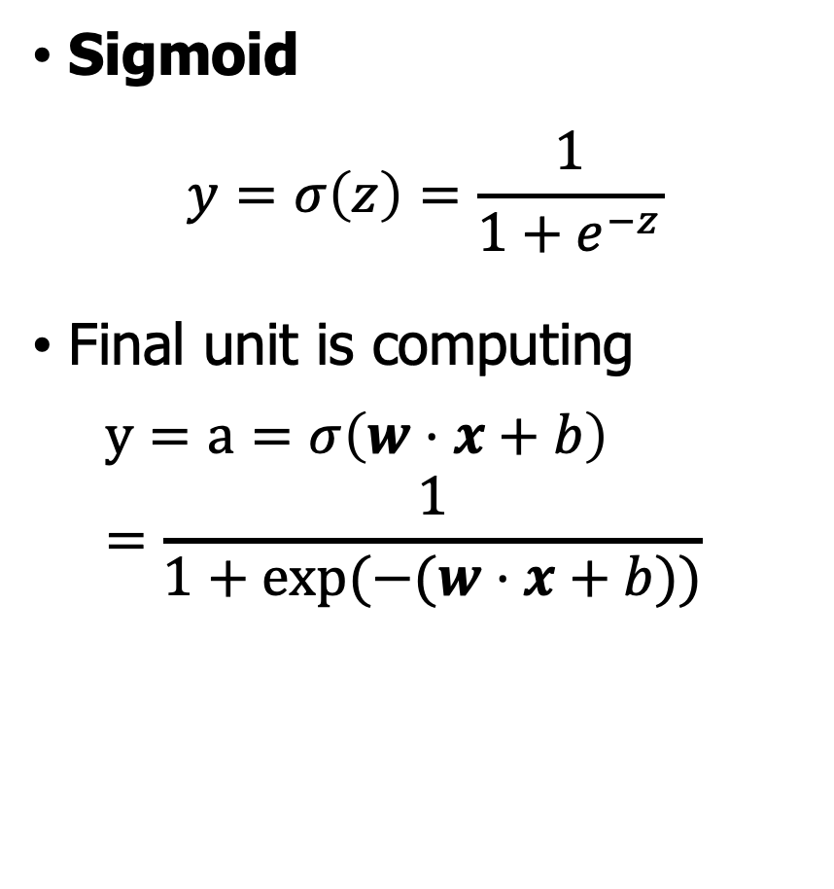

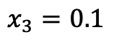
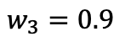
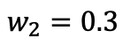

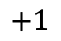
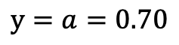
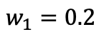
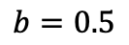
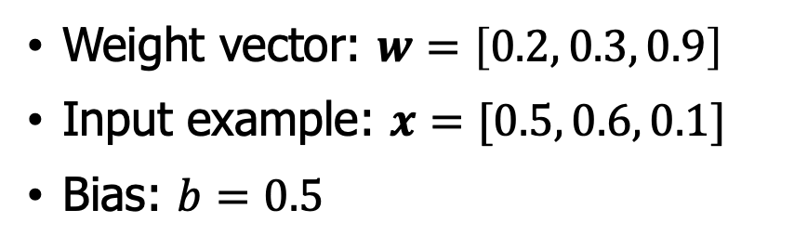
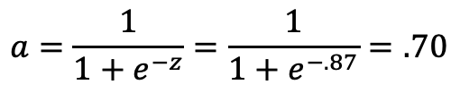
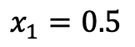
Non-Linear Activations
Sigmoid
$$y=σ\left(z\right)=\frac{1}{1+e^{−z}}$$
Final unit is computing
$$y=a=σ\left(w⋅x+b\right)=\frac{1}{1+\exp{(−(w⋅x+b))}}$$
$$y=a=0.70$$
$$a=\frac{1}{1+e^{−z}}=\frac{1}{1+e^{−.87}}=.70$$
$$σ$$
$$z=.2∗.5+.6∗.3+.1∗.9+.5=0.87$$
Weight vector: $w=\left[0.2, 0.3, 0.9\right]$
Input example: $x=[0.5, 0.6, 0.1]$
Bias: $b=0.5$
$$w_{1}=0.2$$
$$w_{2}=0.3$$
$$w_{3}=0.9$$
$$b=0.5$$
$$x_{1}=0.5$$
$$x_{2}=0.6$$
$$x_{3}=0.1$$
$$+1$$

Slide 6
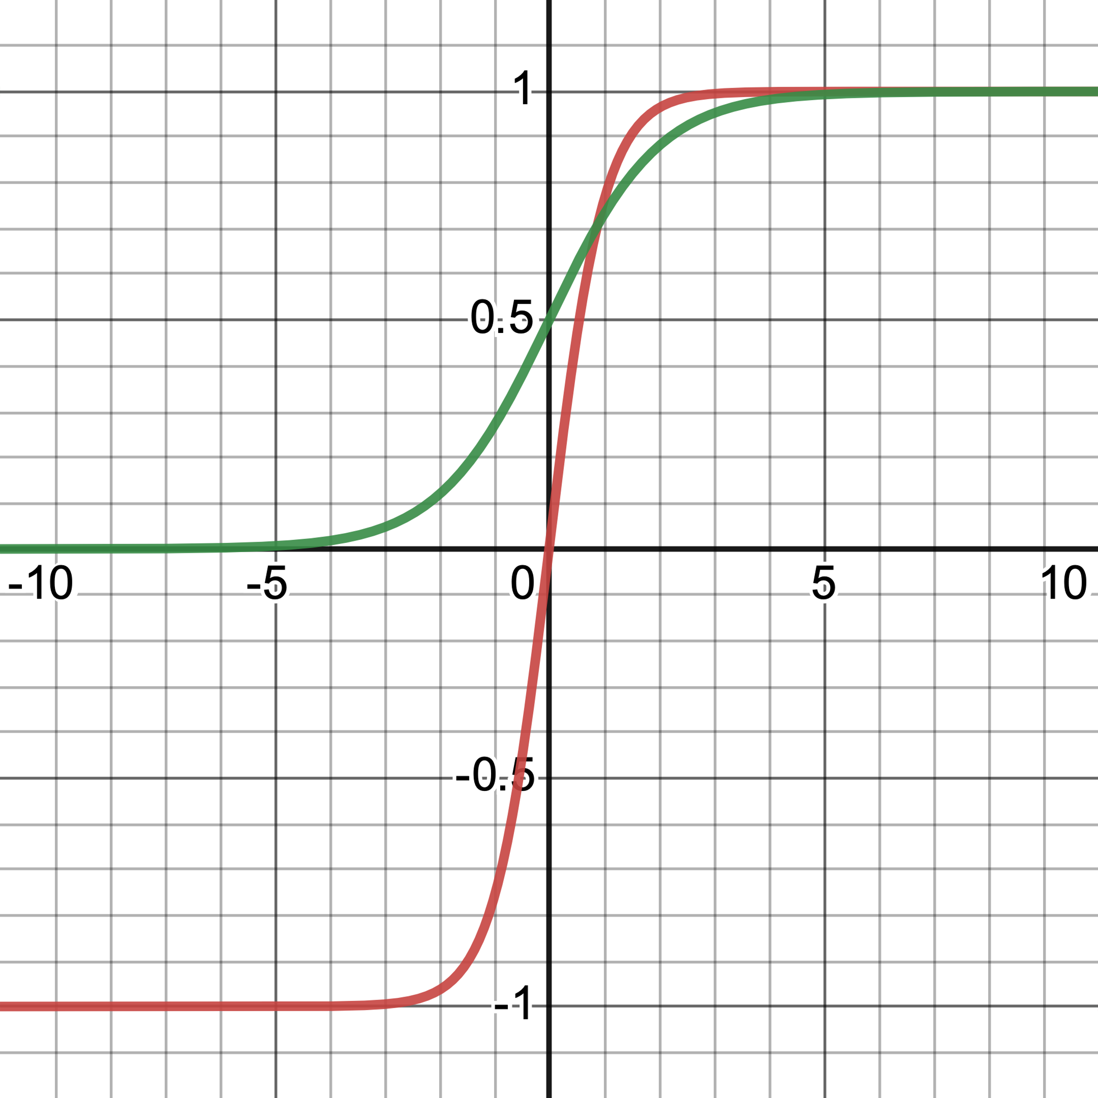
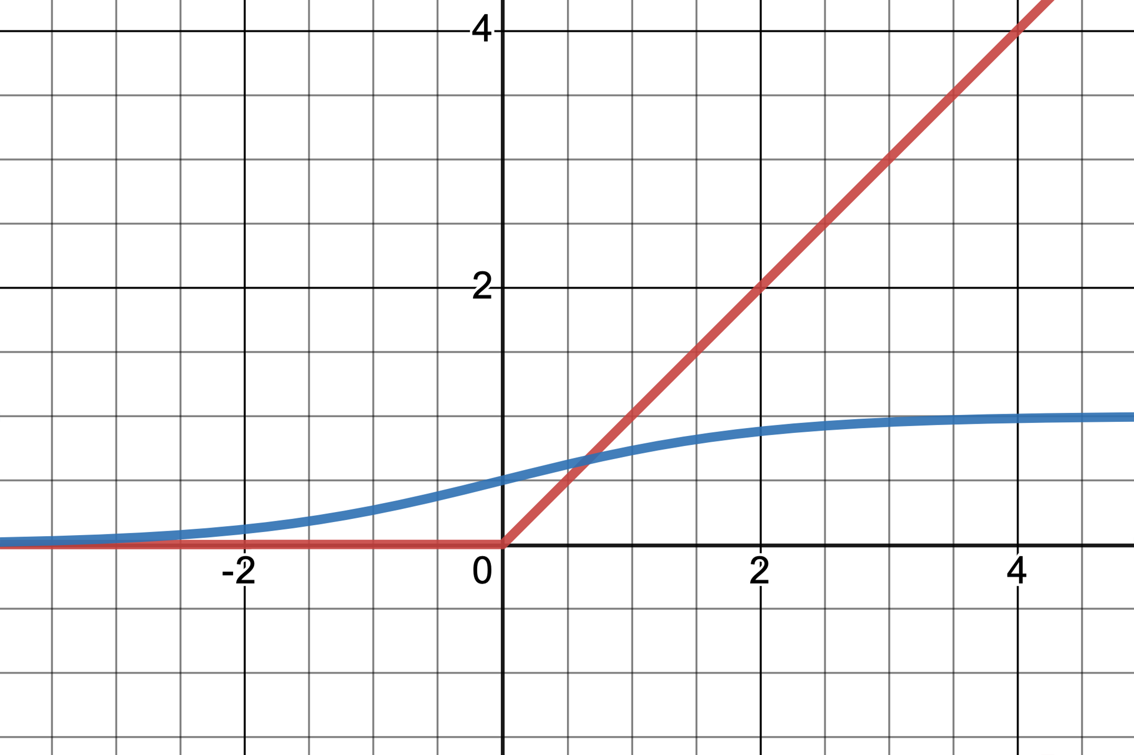
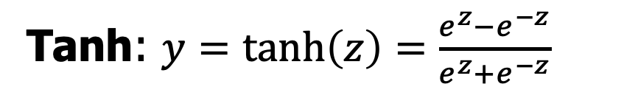

Non-Linear Activations
Tanh: $y=\tanh\left(z\right)=\frac{e^{z}−e^{−z}}{e^{z}+e^{−z}}$
Rectified Linear Unit (ReLU):
$$y=\max\left(z,0\right)$$
tanh
ReLU
sigmoid
sigmoid
Thanks to https://www.desmos.com/calculator
Notes:
在某些情况下，tanh激活函数比Sigmoid激活函数更适合用于神经网络。这主要归因于以下几个原因：
输出范围：tanh函数的输出范围为[-1, 1]，而Sigmoid函数的输出范围为[0, 1]。由于tanh函数以0为中心，其输出具有正负对称性，这意味着神经元的输出将具有更强的表达能力。
梯度强度：tanh函数相对于Sigmoid函数具有更强的梯度强度。在tanh函数的接近0的区域，梯度值相对较大，因此神经网络的学习速度可能更快。
零均值特性：由于tanh函数的输出是零均值的，它可以减少不同层之间的偏移，从而提高训练的稳定性。Sigmoid函数的输出始终为正，这可能导致训练过程中的优化变得更加困难。
尽管tanh在某些情况下比Sigmoid表现得更好，但它们都容易受到梯度消失问题的影响。这就是为什么现代神经网络通常使用其他激活函数，如ReLU（整流线性单元）及其变体，因为它们在很大程度上解决了这些问题。然而，在某些特定的场景和网络架构中，tanh和Sigmoid激活函数仍然具有一定的应用价值。
ReLU（整流线性单元）在神经网络中的作用主要是作为激活函数。激活函数的主要目的是在神经网络中引入非线性，这使得神经网络能够学习和表示复杂的非线性函数。ReLU是一种非常流行且高效的激活函数，具有以下特点：
简单：ReLU函数本身非常简单，即 f(x) = max(0, x)，即当输入值大于0时，函数值等于输入值，而当输入值小于或等于0时，函数值为0。这种简单性使得ReLU在计算上非常高效。
稀疏激活：ReLU的一个重要特点是它引入了稀疏激活。由于负数的输入值会被整流为0，神经网络中的很多神经元实际上是不活跃的。这种稀疏激活有助于减少神经元之间的相互依赖，提高网络的泛化能力。
缓解梯度消失问题：传统的Sigmoid和tanh激活函数在输入值非常大或非常小时，梯度值接近于0，这可能导致梯度消失问题。然而，ReLU在输入值大于0时，梯度始终为1，因此在一定程度上缓解了梯度消失问题。
训练速度：ReLU的计算效率和稀疏激活特性使得训练神经网络的速度比使用其他激活函数更快。
然而，ReLU也有一些缺点，例如“死亡ReLU”问题。当神经元的输出始终为0时，该神经元将无法通过反向传播进行学习。为了解决这个问题，后来提出了一些ReLU的变体，如Leaky ReLU和Parametric ReLU。总的来说，ReLU及其变体在神经网络中得到了广泛的应用，因为它们简单、高效且能有效地引入非线性。

Slide 7
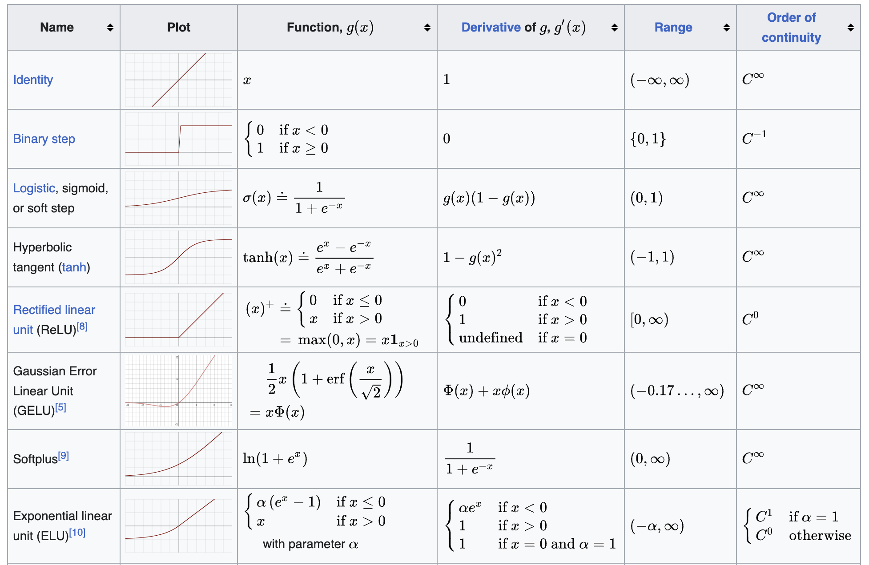
Other Non-Linear Activation Functions
https://en.wikipedia.org/wiki/Activation_function
Notes:
常见的其他激活函数，例如GELU，ELU

Slide 8
Outline
Units in Neural Networks
The XOR problem

Slide 9
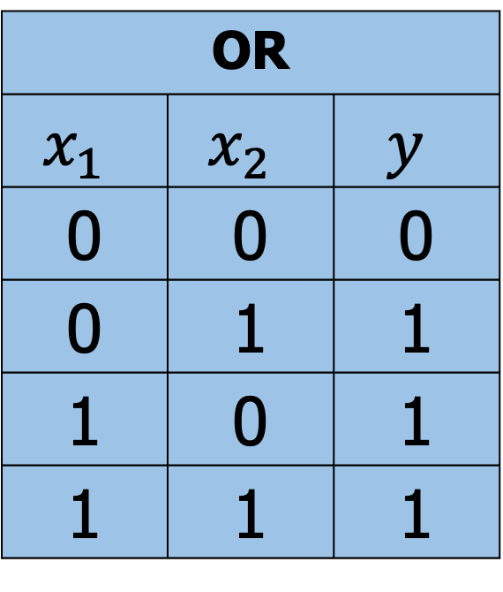
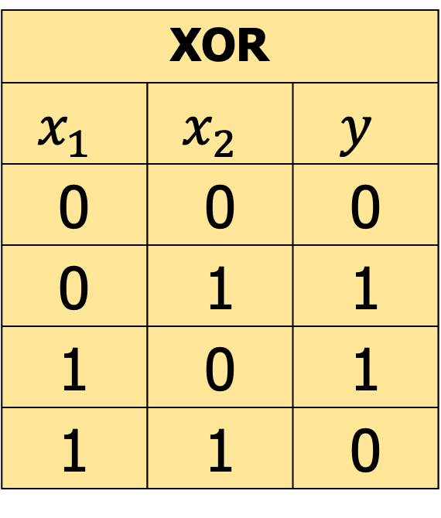
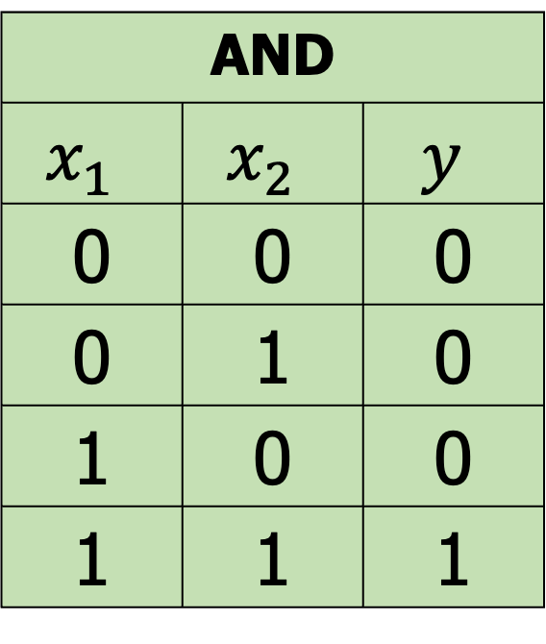
The XOR problem
AND
$$x_{1}$$ | $$x_{2}$$ | $$y$$
0 | 0 | 0
0 | 1 | 0
1 | 0 | 0
1 | 1 | 1
OR
$$x_{1}$$ | $$x_{2}$$ | $$y$$
0 | 0 | 0
0 | 1 | 1
1 | 0 | 1
1 | 1 | 1
XOR
$$x_{1}$$ | $$x_{2}$$ | $$y$$
0 | 0 | 0
0 | 1 | 1
1 | 0 | 1
1 | 1 | 0
Can single neural unit compute simple functions of input?
Notes:
逻辑门问题：有与门、或门、与非门。

Slide 10
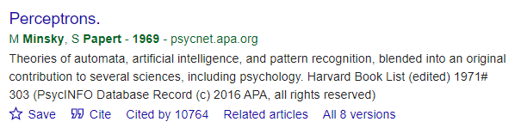
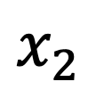

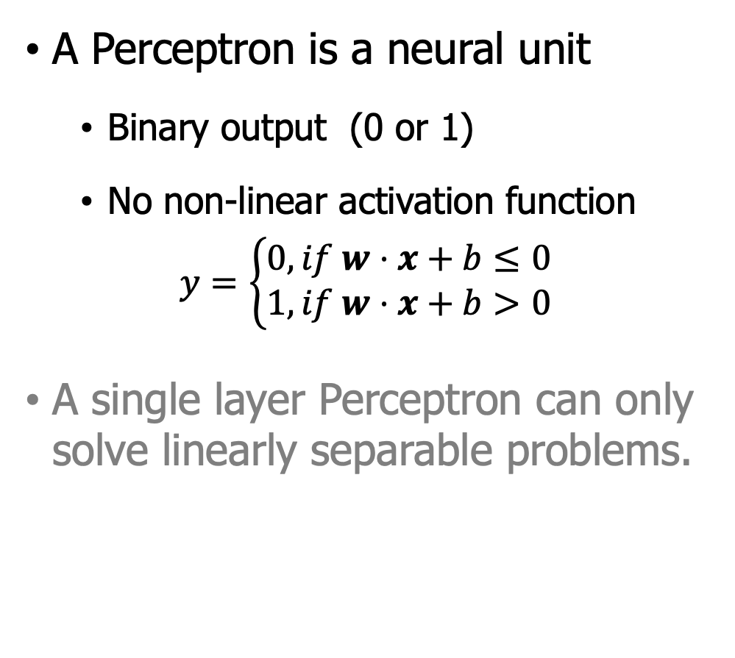
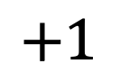
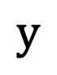
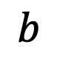
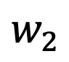

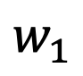
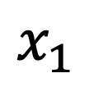
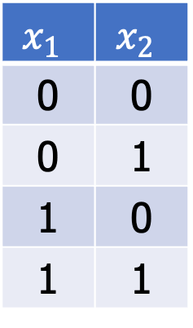
Single Layer Perceptron (SLP)
A Perceptron is a neural unit
Binary output (0 or 1)
No non-linear activation function
$$y=\left\{\begin{aligned}0, if w⋅x+b≤0 \\ 1, if w⋅x+b>0\end{aligned}\right.$$
A single layer Perceptron can only solve linearly separable problems.
$$y$$
$$x_{1}$$ | $$x_{2}$$
0 | 0
0 | 1
1 | 0
1 | 1
$$ReLU$$
$$w_{1}$$
$$w_{2}$$
$$b$$
$$x_{1}$$
$$x_{2}$$
$$+1$$
SLP
Minsky, Marvin, and Seymour Papert. “Perceptrons”, 1969.

Slide 11

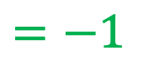
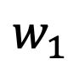

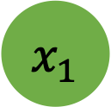

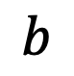
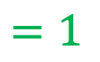
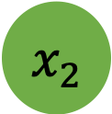
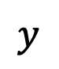
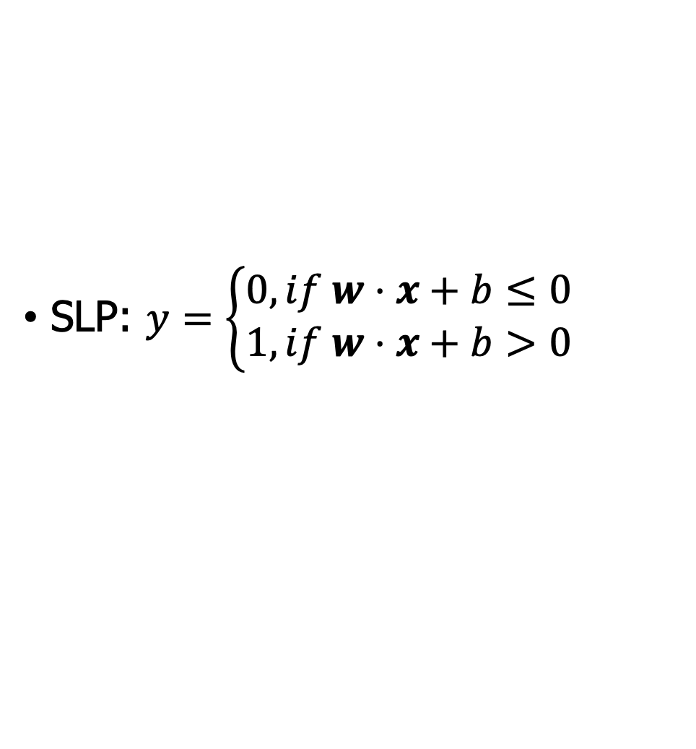
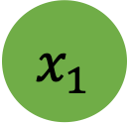











Easy to build AND or OR with SLP
SLP: $y=\left\{\begin{aligned}0, if w⋅x+b≤0 \\ 1, if w⋅x+b>0\end{aligned}\right.$
$$x_{1}$$
$$w_{1}$$
$$=1$$
$$x_{1}$$
$$w_{1}$$
AND
$$x_{1}$$ | $$x_{2}$$ | $$y$$
0 | 0 | 0
0 | 1 | 0
1 | 0 | 0
1 | 1 | 1
$$=1$$
OR
$$x_{1}$$ | $$x_{2}$$ | $$y$$
0 | 0 | 0
0 | 1 | 1
1 | 0 | 1
1 | 1 | 1
$$x_{2}$$
$$w_{2}$$
$$=1$$
$$ReLU$$
$$y$$
$$w_{2}$$
$$=1$$
$$ReLU$$
$$x_{2}$$
$$y$$
$$b$$
$$=−1$$
$$b$$
$$=0$$
+1
+1
AND
OR
How about setting weights:
$w=\left[1,1\right], b=−1$ ?
How about setting weights:
$w=\left[1,1\right], b=0$ ?
Solving AND and OR problem with SLP is easy.

Slide 12




















Is it possible to capture XOR with SLP?
SLP: $y=\left\{\begin{aligned}0, if w⋅x+b≤0 \\ 1, if w⋅x+b>0\end{aligned}\right.$
XOR
$$x_{1}$$ | $$x_{2}$$ | $$y$$
0 | 0 | 0
0 | 1 | 1
1 | 0 | 1
1 | 1 | 0
$$x_{1}$$
$$w_{1}$$
$$=1$$
$$x_{1}$$
$$w_{1}$$
$$=1$$
$$x_{2}$$
$$w_{2}$$
$$=1$$
$$ReLU$$
$$y$$
$$x_{2}$$
$$w_{2}$$
$$=1.1$$
$$ReLU$$
$$y$$
$$b$$
$$=−1$$
$$b$$
$$=−.9$$
+1
+1
Given this SLP, you can try many different $w$ and $b$, I am sure you will fail!
Fail when $x_{1}=0,x_{2}=1$
$w⋅x+b=0,$ so $y=0$
Fail when $x_{1}=1,x_{2}=1$
$w⋅x+b=1.2,$ so $y=1$

Slide 13




Why cannot? SLP is a linear classifier
SLP boundary is the equation of a line
$$w_{1}x_{1}+w_{2}x_{2}+b=0$$
Standard format: $x_{2}=\left(−\frac{w_{1}}{w_{2}}\right)x_{1}+\left(\frac{−b}{w_{2}}\right)$
The line acts as a decision boundary
0 if input is on one side of the line
1 if on the other side of the line
$$4⋅x_{1}+5⋅x_{2}−6=0$$
$$x=x_{1},y=x_{2}$$
$$w_{1}=4,w_{2}=5,b=−6$$

Slide 14






















Not possible to capture XOR with SLP
$$x_{2}$$
$$x_{2}$$
$$x_{2}$$
$$1$$
$$1$$
$$1$$
$$0$$
$$x_{1}$$
$$0$$
$$x_{1}$$
$$0$$
$$x_{1}$$
$$0$$
$$1$$
$$0$$
$$1$$
$$0$$
$$1$$
$x_{1}$AND $x_{2}$
$x_{1}$OR $x_{2}$
$x_{1}$XOR $x_{2}$
Data point with label $y=0$
Data point with label $y=1$
XOR is not linear separable!

Slide 15






















Solution to the XOR problem
XOR cannot be calculated by a single perceptron
XOR can be calculated by a layered network of units
XOR
$$x_{1}$$ | $$x_{2}$$ | $$y$$
0 | 0 | 0
0 | 1 | 1
1 | 0 | 1
1 | 1 | 0
$$x_{1}$$
$$w_{1}$$
$$x_{1}$$
$$w_{11}$$
$$h_{1}$$
$$w_{31}$$
$$w_{12}$$
$$y$$
$$w_{21}$$
$$w_{32}$$
$$x_{2}$$
$$w_{2}$$
$$x_{2}$$
$$ReLU$$
$$y$$
$$h_{2}$$
$$w_{22}$$
$$b$$
$$b_{1}$$
$$b_{2}$$
$$b_{3}$$
+1
+1
+1
SLP
NN: three ReLU units

Slide 16





















The hidden representation $h$
$$x_{1}$$
$$1$$
$$h_{1}$$
$$x_{2}$$
$$1$$
$$h_{2}$$
$$1$$
$$y$$
$$1$$
$$−2$$
$$1$$
$$x_{2}$$
$$1$$
$$1$$
$$h_{2}$$
$$0$$
$$−1$$
$$0$$
+1
+1
$$0$$
$$0$$
$$0$$
$$1$$
$$x_{1}$$
$$0$$
$$1$$
$$2$$
$$h_{1}$$
The original $x$ space
Neural Network
The new (linearly separable) $h$ space

Slide 17
Outline
Units in Neural Networks
The XOR problem
Feedforward Neural Networks
Notes:
feedforward neural network (FNN) 前馈神经网络

Slide 18











Feedforward Neural Networks (FNN)
$$x_{1}$$
$$W$$
$$h_{1}$$
$$U$$
$$y_{1}$$
FNN is multilayer network
Units are connected with no cycles
Outputs from units in each layer are passed to units in the next
Sometimes called Multi-Layer Perceptrons (or MLPs)
$$x_{2}$$
$$h_{2}$$
$$y_{2}$$
…
…
…
$$x_{n_{0}}$$
$$h_{n_{1}}$$
$$y_{n_{2}}$$
+1
Input Layer Hidden Layer Output Layer

Slide 19















Binary LR as a 1-layer Network
We don't count the input layer: Input layer=0th layer
$$y$$
Output layer $σ$ node
$$σ$$
$y=σ(w⋅x+b)$
(y is a scalar)
$w$ is a vector
$$w_{1}$$
$$w_{2}$$
$$w_{3}$$
$$w_{n}$$
$$b$$
Input layer vector $x$
$$x_{1}$$
$$x_{2}$$
$$x_{3}$$
…
$$x_{n}$$
+1

Slide 20











Multinomial LR as a 1-layer Network
Fully connected single layer network
Quick recall of Softmax
Output layer (softmax nodes)
$$y_{1}$$
…
$$y_{n}$$
$y=softmax(w⋅x+b)$
(y is a scalar)
$W$ is a matrix
$$W$$
$b$, a vector
Input layer $x$
$$x_{1}$$
$$x_{2}$$
$$x_{3}$$
$$x_{n}$$
+1

Slide 21
















Two-Layer Network with scalar output
Output layer
($σ$ nodes)
$$y$$
$y=σ(z)$ (y is a scalar)
$z=Uh$
$$U$$
Hidden units
($σ$ nodes)
$$h_{1}$$
$$h_{2}$$
$$h_{3}$$
$$h=σ\left(w⋅x+b\right)$$
Could be ReLU, tanh, ...
$$W$$
$b$ is a vector.
Input layer
vector $x$
$$x_{1}$$
$$x_{2}$$
$$x_{3}$$
$$x_{n}$$
+1

Slide 22



Two-Layer Network with scalar output
Output layer
($σ$ nodes)
$$y$$
$y=σ(z)$ (y is a scalar)
$z=Uh$
$$U$$
Hidden units
($σ$ nodes)
$$h_{1}$$
$$h_{j}$$
$$h_{3}$$
$$h=σ\left(w⋅x+b\right)$$
Could be ReLU, tanh, ...
$$W_{ij}$$
$$W$$
$b$ is a vector.
Input layer
vector $x$
$$x_{1}$$
$$x_{2}$$
$$x_{i}$$
$$x_{n}$$
+1

Slide 23


















Two-Layer Network with softmax output
Output layer
($σ$ nodes)
$$y_{1}$$
$$y_{2}$$
$$y_{3}$$
$y=σ(z)$ (y is a vector)
$z=Uh$
$$U$$
$$h=σ\left(w⋅x+b\right)$$
Hidden units
($σ$ nodes)
$$h_{1}$$
$$h_{2}$$
$$h_{3}$$
Could be ReLU, tanh ...
$$W$$
$b$ is a vector.
Input layer
vector $x$
$$x_{1}$$
$$x_{2}$$
$$x_{3}$$
$$x_{n}$$
+1

Slide 24













Single hidden layer notation
$$x_{1}$$
$$W$$
$$h_{1}$$
$$U$$
$$y_{1}$$
$$h=σ\left(Wx+b\right)$$
$z=Uh$
$y=softmax(z)$
$$x_{2}$$
$$h_{2}$$
$$y_{2}$$
…
…
…
$$x_{n_{0}}$$
$$h_{n_{1}}$$
$$y_{n_{2}}$$
+1
$$b$$
Input Layer Hidden Layer Output Layer

Slide 25















Multi-layer Notation
$${y=a}^{[2]}$$
$$b^{[2]}$$
$$W^{[2]}$$
$$a^{[2]}=g^{\left[2\right]}(z^{\left[2\right]})$$
$$a^{[1]}$$
$$z^{[2]}=W^{[2]}a^{[1]}+b^{[2]}$$
$$W^{[1]}$$
$$b^{[1]}$$
$$a^{[1]}=g^{\left[1\right]}\left(z^{\left[1\right]}\right)$$
$$z^{[1]}=W^{[1]}a^{[0]}+b^{[1]}$$
$$x_{1}$$
$$x_{2}$$
$$x_{3}$$
$$x_{n}$$
+1
$$a^{[0]}$$

Slide 26







Replacing the bias unit
Instead of: We do this:
$$x=x_{1},x_{2},…,x_{n_{0}}$$
$$x=x_{0},x_{1},x_{2},…,x_{n_{0}}$$
$$h=σ\left(Wx+b\right)$$
$$h=σ\left(Wx\right)$$
$$h_{j}=σ\left(\sum_{i=1}^{n_{0}}{W_{ji}x_{i}+b_{j}}\right)$$
$$h_{j}=σ\left(\sum_{i=0}^{n_{0}}{W_{ji}x_{i}}\right)$$
Add a dummy node $a0=1$ to each layer
Its weight w₀ will be the bias
So input layer a^{[0]}₀=1, a^{[1]}₀=1 , a^{[2]}₀=1,…

Slide 27





















Replacing the bias unit
Instead of:
We'll do this:
$$W$$
$$U$$
$$x_{1}$$
$$W$$
$$h_{1}$$
$$U$$
$$y_{1}$$
$$x_{0}$$
$$h_{1}$$
$$y_{1}$$
$$x_{1}$$
$$x_{2}$$
$$h_{2}$$
$$y_{2}$$
$$h_{2}$$
$$y_{2}$$
$$x_{2}$$
…
…
…
…
…
$$x_{n_{0}}$$
$$h_{n_{1}}$$
$$y_{n_{2}}$$
…
$$x_{n_{0}}$$
$$h_{n_{1}}$$
$$y_{n_{2}}$$
+1
$$b$$
$$b$$

Slide 28
Outline
Units in Neural Networks
The XOR problem
Feedforward Neural Networks (FNNs)
Applying FNNs to NLP tasks
Sentiment classification via FNNs

Slide 29

Recall: Sentiment classification
It's hokey . There are virtually no surprises , and the writing is second-rate. So why was it so enjoyable ? For one thing , the cast is great . Another nice touch is the music. I was overcome with the urge to get off the couch and start dancing. It sucked me in , and it'll do the same to you.
Variable | Definition | Value
$$x_{1}$$ | count(positive lexicon words $∈$ doc) | 3
$$x_{2}$$ | count(negative lexicon words $∈$ doc) | 2
$$x_{3}$$ | $\left\{\begin{aligned}1 if \text{no}∈doc \\ 0 otherwise\end{aligned}\right.$ | 1
$$x_{4}$$ | count(1st and 2nd pronouns $∈$ doc) | 3
$$x_{5}$$ | $\left\{\begin{aligned}1 if !∈doc \\ 0 otherwise\end{aligned}\right.$ | 0
$$x_{6}$$ | log(word count of doc) | $$\ln\left(66\right)=4.19$$

Slide 30







Classification: Sentiment Analysis
We could do exactly what we did with logistic regression
Input layer are features as before
Output layer is 0 or 1
$$σ$$
U
Variable | Definition | Value
$$x_{1}$$ | count(positive lexicon words $∈$ doc) | 3
$$x_{2}$$ | count(negative lexicon words $∈$ doc) | 2
$$x_{3}$$ | $\left\{\begin{aligned}1 if \text{no}∈doc \\ 0 otherwise\end{aligned}\right.$ | 1
$$x_{4}$$ | count(1st and 2nd pronouns $∈$ doc) | 3
$$x_{5}$$ | $\left\{\begin{aligned}1 if !∈doc \\ 0 otherwise\end{aligned}\right.$ | 0
$$x_{6}$$ | log(word count of doc) | $$\ln\left(66\right)=4.19$$
W
$$x_{1}$$
$$x_{2}$$
$$x_{3}$$
$$x_{4}$$
$$x_{n}$$
Notes:
那么我们怎么使用神经网络来做情感分析呢？
其实可以跟我们使用逻辑回归来训练一个情感分类器一样。我们可以做同样的事情。
这里网络的输入就是构建的本文特征，输出就是0 或者 1.

Slide 31






















FNNs for simple classification
Logistic Regression
2-layer feedforward network
$$σ$$
$$σ$$
U
…
$$w_{n}$$
Hidden layer
$$w_{1}$$
$$w_{2}$$
$$w_{3}$$
W
$$x_{1}$$
$$x_{2}$$
$$x_{3}$$
$$x_{n}$$
…
$$x_{1}$$
$$x_{2}$$
$$x_{3}$$
$$x_{n}$$
$$feature 1$$
$$feature 2$$
$$feature 3$$
$$feature n$$
$$feature 1$$
$$feature 2$$
$$feature 3$$
$$feature n$$
Just adding a hidden layer to logistic regression
allows the network to use non-linear interactions between features
which may (or may not) improve performance

Slide 32

2-layer FNN classifier
Input layer
Scalar features like, $x_{1} = count(words∈doc)$, $x2 = count(positive words∈ doc)$ etc.
Output layer
2 nodes (one each for positive and negative)
3 nodes (positive, negative, neutral)
The 2-layer model could be
$x=[x_{1},x_{2},…, x_{N}]$ each $x_{i}$ is a hand-designed feature.
$h=σ(Wx+b)$
$z=Uh$
$\hat{y}=softmax\left(z\right)$

Slide 33

2-layer FNN classifier
Can we do better? How ?

Slide 34

Even better: representation learning
Instead of using hand-built human-engineered features for classification, use learned representations like embeddings!
The pic is from Fast Forward labs, https://blog.fastforwardlabs.com/2020/11/15/representation-learning-101-for-software-engineers.html

Slide 35


FNN classifier with embeddings
Representing words as embeddings, like the word2vec or GloVe vectors
From text sample to feature vector: Design a pooling function for all the words in the input, e.g.,
$$x_{mean}=\frac{1}{n}\sum_{i=1}^{n}{e(w_{i})}$$
Word representations
dessert
was
great
this
.
.
.
the
which
2
0.1
0.3
-2
0.5
0.2
-2
0.2
4
0.7
0.2
0.8
.
.
.
.
.
.
.
.
.
$x=mean ({e(x}_{1}),e(x_{2}),…, e(x_{n}))$
$h=σ(Wx+b)$
$z=Uh$
$\hat{y}=softmax\left(z\right)$
1
3
0.7
5
3
0.2

Slide 36

FNN classifier with embeddings
Final equations:
$x=mean ({e(x}_{1}),e(x_{2}),…, e(x_{n}))$
$H=σ\left(XW^{⊤}+b\right)$
$Z=HU^{⊤}$
$\hat{Y}=softmax (Z)$
Other options:
element-wise max
Weighted mean
Many others

Slide 37

FNN classifier with embeddings

Slide 38

Concept of pretraining
Pretraining: The idea of using word2vec or GloVe embeddings as our inputs —and more generally the idea of relying on another algorithm to have already learned an embedding for our inputs
BERT: Pre-training of Deep Bidirectional Transformers for Language Understanding

Slide 39
Outline
Units in Neural Networks
The XOR problem
Feedforward Neural Networks
Applying feedforward networks to NLP tasks
Sentiment classification via FNNs
Neural Language Models (LMs)

Slide 40
Neural Language Models (LMs)
Language Modeling: Calculating the probability of the next word in a sequence given some history
We've seen N-gram based LMs
But neural network LMs far outperform n-gram language models
State-of-the-art neural LMs are based on more powerful neural network technology like Transformers
But simple feedforward LMs can do almost as well!

Slide 41

Simple FNN Neural Language Models
Same as N-gram model
Task: predict next word $w_{t}$
given prior words $w_{1}$, $w_{2}$, $w_{3}$, …
Problem: Now we’re dealing with sequences of arbitrary length
Solution: Sliding windows (of fixed length)

Slide 42


Neural Language Model with embeddings
At each timestep:
Compute a d-dimensional embedding for each context word (by multiplying a one-hot vector by the embedding matrix E
Concatenates the 3 resulting embeddings to get the embedding layer e
Embedding vector e is multiplied by a weight matrix W and then an activation is applied element-wise to produce the hidden layer h
…
Final equations:
$$e=\left[Ex_{t−3},Ex_{t−2},Ex_{t−1}\right]$$
$h=σ\left(We+b\right)$
$z=Uh$
$\hat{Y}=softmax (z)$

Slide 43

NLM with embeddings as parameters
Learn the embeddings simultaneously with training the network.
Useful when the task the network is designed for (like sentiment classification, translation, or parsing) places strong constraints on what makes a good representation for words.
Embeddings as model parameters

Slide 44
Why Neural LMs work better than N-gram LMs
N-gram language models: represent words by their word identity
Neural language models: represent words in this prior context by their embeddings
Training data:
We've seen: I have to make sure that the cat gets fed.
Never seen: dog gets fed
Test data:
I forgot to make sure that the dog gets ___
N-gram LM can't predict "fed"!
Neural LM can use similarity of "cat" and "dog" embeddings to generalize and predict “fed” after dog

Slide 45
Outline
Units in Neural Networks
The XOR problem
Feedforward Neural Networks
Applying feedforward networks to NLP tasks
Sentiment classification via FNNs
Neural Language Models (LMs)
Training Neural Nets

Slide 46

















Intuition: training a 2-layer Network
Actual answer $y$
$$y_{1}$$
$$y_{2}$$
$$y_{3}$$
Loss L($\hat{y},y$)
$${\hat{y}}_{1}$$
$${\hat{y}}_{2}$$
$${\hat{y}}_{3}$$
System output $\hat{y}$
$$U$$
Backward pass
$$h_{1}$$
$$h_{2}$$
$$h_{3}$$
Forward pass
Gradient
$$W$$
$$b$$
Training instance
$$x_{1}$$
$$x_{2}$$
$$x_{3}$$
$$x_{n}$$
+1

Slide 47

Intuition: training a 2-layer network
For every training tuple $(x,y)$
Run forward computation to find our estimate $\hat{y}$
Run backward computation to update weights:
For every output : Compute loss $L$between true $y$ and the estimated $\hat{y}$
For every weight $w$from hidden layer to the output layer: Update the weight
For every hidden node
Assess how much blame it deserves for the current answer

Slide 48
Reminder: Loss Function for binary LR
A measure for how far off the current answer is to the right answer
Cross entropy loss for logistic regression:

Slide 49

Reminder: SGD for weight updates
Use the derivative of the loss function with respect to weights $\frac{d}{dw}L(f\left(x;w\right),y)$
To tell us how to adjust weights for each training item
Move them in the opposite direction of the gradient
$$w^{t+1}=w^{t}−η_{t}\frac{∂L\left(f\left(x;w\right),y\right)}{∂w}$$
For logistic regression

Slide 50














Where did that derivative come from?
$$y$$
Using the chain rule! f (x) = u(v(x))
$$a$$
$$σ$$
$$z$$
$\frac{∂L}{∂w_{i}}=\frac{∂L}{∂y}$ $\frac{∂y}{∂z}$ $\frac{∂z}{∂w_{i}}$
Derivative of the Loss
$$w_{1}$$
$$w_{2}$$
$$w_{3}$$
$$b$$
Derivative of the Activation
Derivative of the weighted sum
$$x_{1}$$
$$x_{2}$$
$$x_{3}$$
$$+1$$

Slide 51
Gradient for every weight in the network?
These derivatives on the prior slide only give the updates for one weight layer: the last one!
What about deeper networks?
Lots of layers, different activation functions?
Solution:
Use the chain rule!!
Computation graphs and backward differentiation!

Slide 52
Outline
Units in Neural Networks
The XOR problem
Feedforward Neural Networks
Applying feedforward networks to NLP tasks
Sentiment classification via logistic regression
Sentiment classification via Feedforward networks
Neural Language Models (LMs)
Training Neural Nets
Computation Graphs and Backward Differentiation

Slide 53
Why Computation Graphs
For training, we need the derivative of the loss with respect to each weight in every layer of the network
But the loss is computed only at the very end of the network!
Solution: error backpropagation (Rumelhart, Hinton, Williams, 1986)
Backprop is a special case of backward differentiation
Which relies on computation graphs.

Slide 54



Computation Graphs
A computation graph represents the process of computing a mathematical expression
Example loss:
Computations:

Slide 55

Backwards differentiation in computation graphs
The importance of the computation graph comes from the backward pass
This is used to compute the derivatives that we’ll need for the weight update.
Example loss:
Computations:
We want:
The derivative $\frac{∂L}{∂a}$, tells us how much a small change in a affects L.

Slide 56
The chain rule
Example
The derivative of all parameters:

Slide 57

Example
All intermediate derivatives

Slide 58

Example: backward pass
Backward pass

Slide 59

Example of a computation graph
Computation graph for the function $L(a,b, c) = c(a+2b)$

Slide 60











Backward differentiation on a two layer network
$$y$$
$$σ$$
$$W^{[2]}$$
$$b^{[2]}$$
ReLU activation
$$W^{[1]}$$
$$b^{[1]}$$
$$x_{1}$$
$$x_{2}$$
$$x_{3}$$
$$x_{n}$$
+1
$$a^{[0]}$$

Slide 61



Backward differentiation on a two layer network
Derivative of ReLU
Derivative of $σ$
Derivative of tanh

Slide 62

Backward differentiation on a 2-layer network
Sample computation graph for a simple 2-layer neural net

Slide 63






Starting off the backward pass: $∂L/∂z$
write $a$ f$or a^{[2]}$ and $z$ for $z^{[2]}$
$$L\left(\hat{y},y\right)=−\left(\text{y}\log{(\hat{y})}+\left(1−y\right)log⁡(1−\hat{y}\text{)}\right)$$
$$L\left(a,y\right)=−\left(y log{a}+\left(1−y\right)log⁡(1−a)\right)$$
$\frac{∂L}{∂z}=\frac{∂L}{∂a}$ $\frac{∂a}{∂z}$
$$\frac{∂L}{∂a}=−\left(\left(y\frac{∂\log\left(a\right)}{∂a}\right)+(1−y) \frac{∂\log\left(1−a\right)}{∂a}\right)$$
$$=−\left(\left(y\frac{1}{a}\right)+\left(1−y\right) \frac{1}{1−a}\left(−1\right)\right)=−\left(\frac{y}{a}+\frac{y−1}{1−a}\right)$$
$$\frac{∂a}{∂z}=a(1−a)$$
$$\frac{∂L}{∂z}=−\left(\frac{y}{a}+\frac{y−1}{1−a}\right)a\left(1−a\right)=a−y$$

Slide 64
Quick Summary
You have learned
Neural units and neural networks (resolve XOR problems)
Feedforward neural networks (FNN)
FNN for classification and modeling
Next lecture: Sequence labeling for POS and Named Entities

